Slide 1
WELCOME TO SPEED!
SPEED Version 1.3 Overview

Slide 2
SPEED
SPEED???

Slide 3
What is SPEED?
Strategic Planning eSubmission and eReporting Dashboard
SPEED was developed by the Business Intelligence Team, part of Tucson’s College of Medicine IT Department (COM-IT)
It was developed to help automate the Strategic Planning for Departments within the University of Arizona College of Medicine and assist with annual reporting

Slide 4
The College has created Mission Areas in an ongoing effort to fulfill its overall Mission Statement:
To advance the health and wellness of our community
and beyond, while embracing diversity, in the pursuit of
excellence through innovation in our tripartite mission: education, research, and patient care.

Slide 5
Mission Areas
Education
Research
Patient Care
Faculty Affairs
Diversity, Equity and Inclusion (DEI)
Finance
Development
Communication and Branding

Slide 6
Where is the SPEED Dashboard? Access the SPEED dashboard via the following link/ location: https://bids.medicine.arizona.edu/data-reports/administration/speed

Slide 7
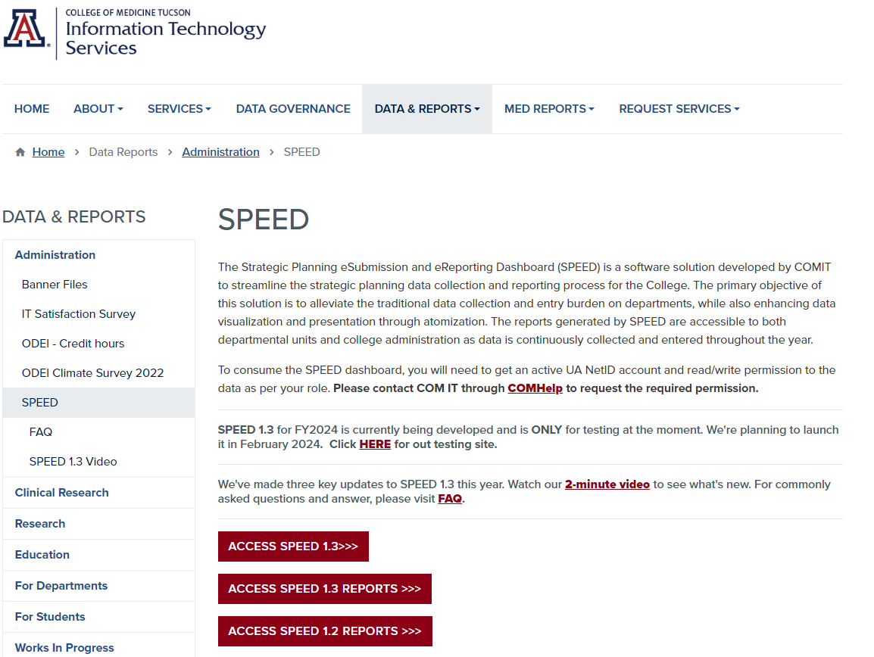
SPEED Dashboard
When entering data in 2024, select the Access SPEED 1.3 option

Slide 8
After selecting, “Access SPEED 1.3” from the previous screen, you will see the following icon. It indicates you are being directed to Microsoft Power BI, where the SPEED website and data reside.

Slide 9
Alternate Way to Access SPEED
There is another way to navigate to the SPEED website. You can go to the COM-ITS BIDS (Business Intelligence and Data Services) website:
https://bids.medicine.arizona.edu/
If you use this link and go directly to the BIDS website, you will see the following screen:

Slide 10
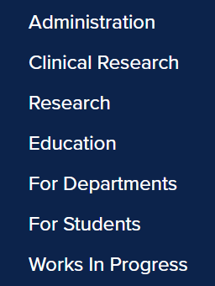
From the Data and Reports drop-down menu select “Administration”

Slide 11
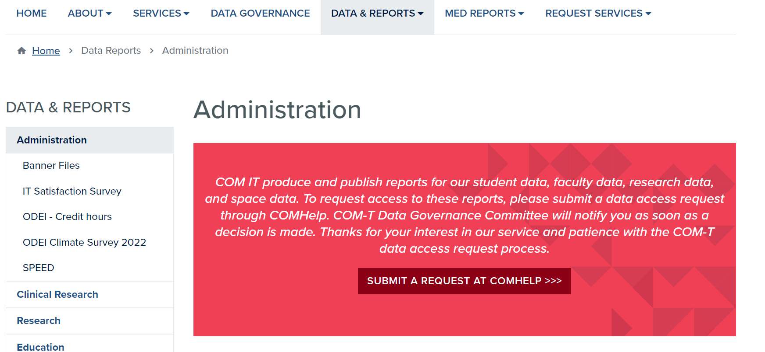
After selecting “Administration” from the previous screen, you will be taken to this screen, where SPEED is located on the left-hand menu
Step 1
Step 2

Slide 12
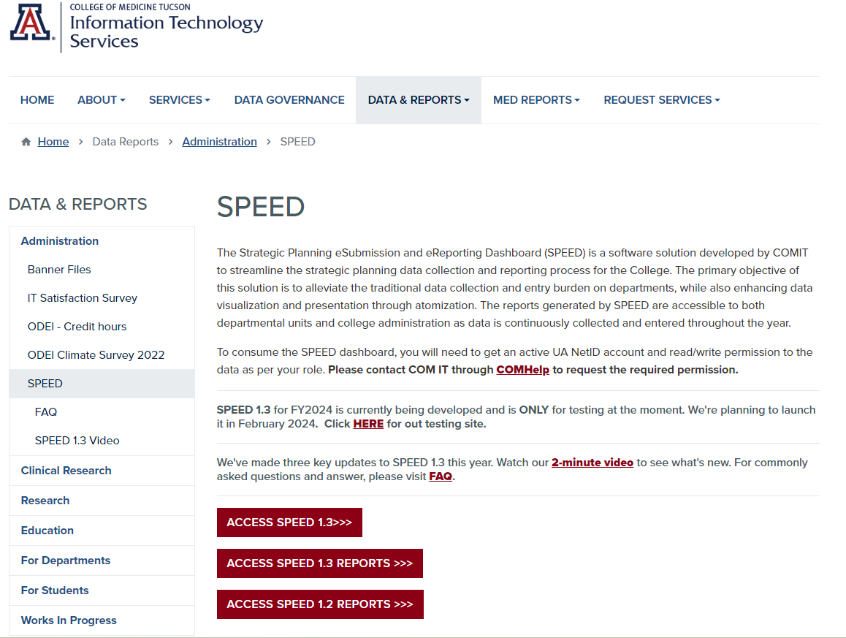
This link is where you go to see your Department’s data and add new data for your Department(s)
Are you or others in your Department auditory learners? You can find a quick 2-minute overview video here
FYI: This link takes you to a training site so other staff can be trained without affecting the “real” (Production) site
FYI: This link takes you to Frequently Asked Questions
Select this button to take you to the live dashboard

Slide 13
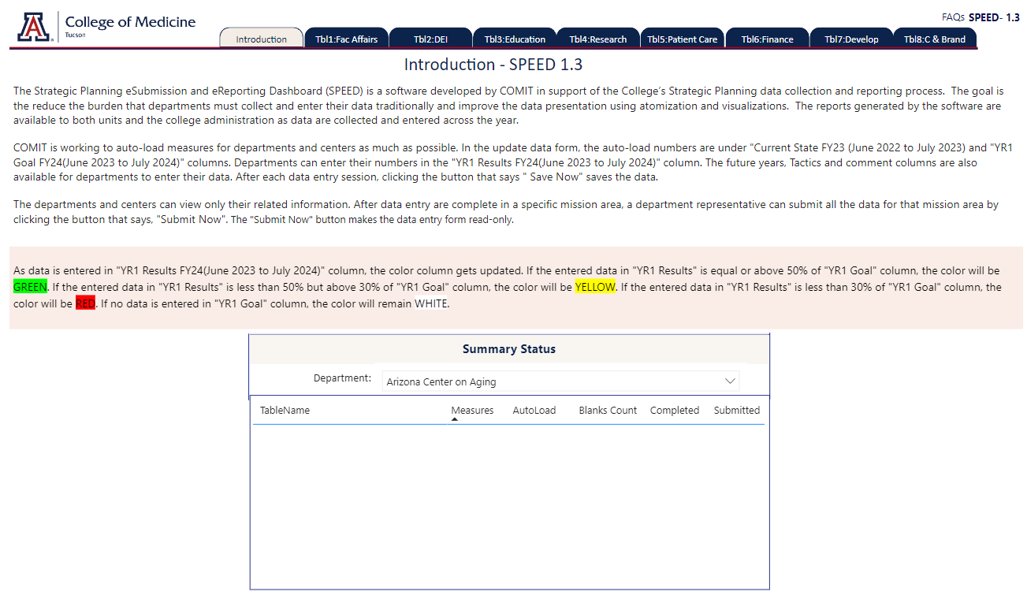
Introduction Tab
There are eight additional tabs, one for each Mission Area
FYI: This information pertains to the data in each Mission Area (see slide #17)
Select your Department from the drop-down menu

Slide 14
Tabs in the SPEED Dashboard
Again, the blue tabs at the top of the website
correspond to the College’s Mission Areas
FYI: All users will be able to see and edit all Mission Areas within their respective department (but will only see data for their department)

Slide 15
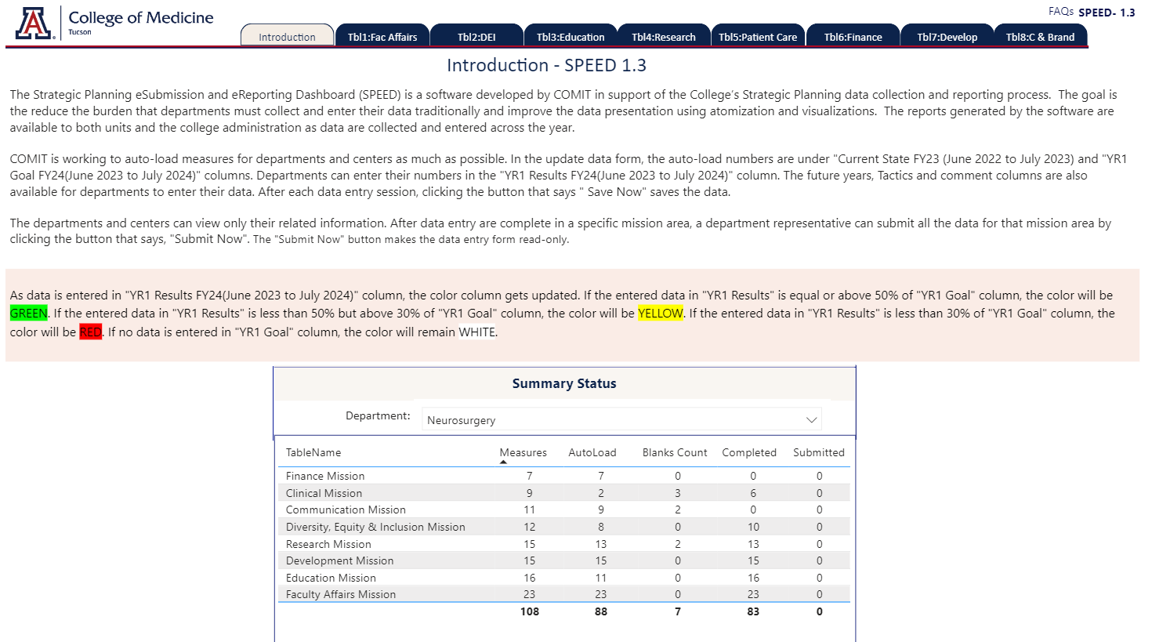
Once you select your Department, your screen will refresh and look like this

Slide 16
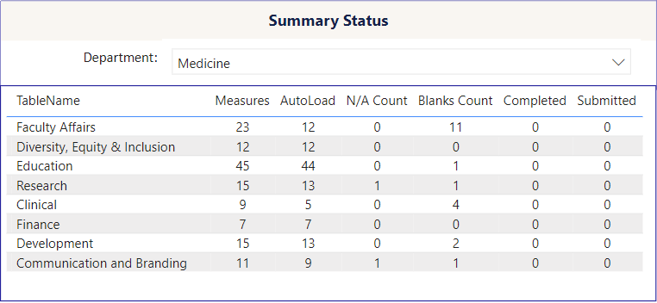
Summary Status Table
This “Measures” column indicates the number of measures for each Mission Area (this number is the same across Departments)
The “Blanks Count” column indicates the number of Measure that must be entered by the Department
The “Completed” column indicates the number of measures added since IT performed the “AutoLoad”
Mission Areas
Upon final submission, the “Submitted” column should equal the number in the Measures column
The “AutoLoad” column indicates how many Measures COM-IT was able to pre-load into the system
The “N/A Count” column indicates how many Measures within a Mission Area are not applicable to that Department

Slide 17
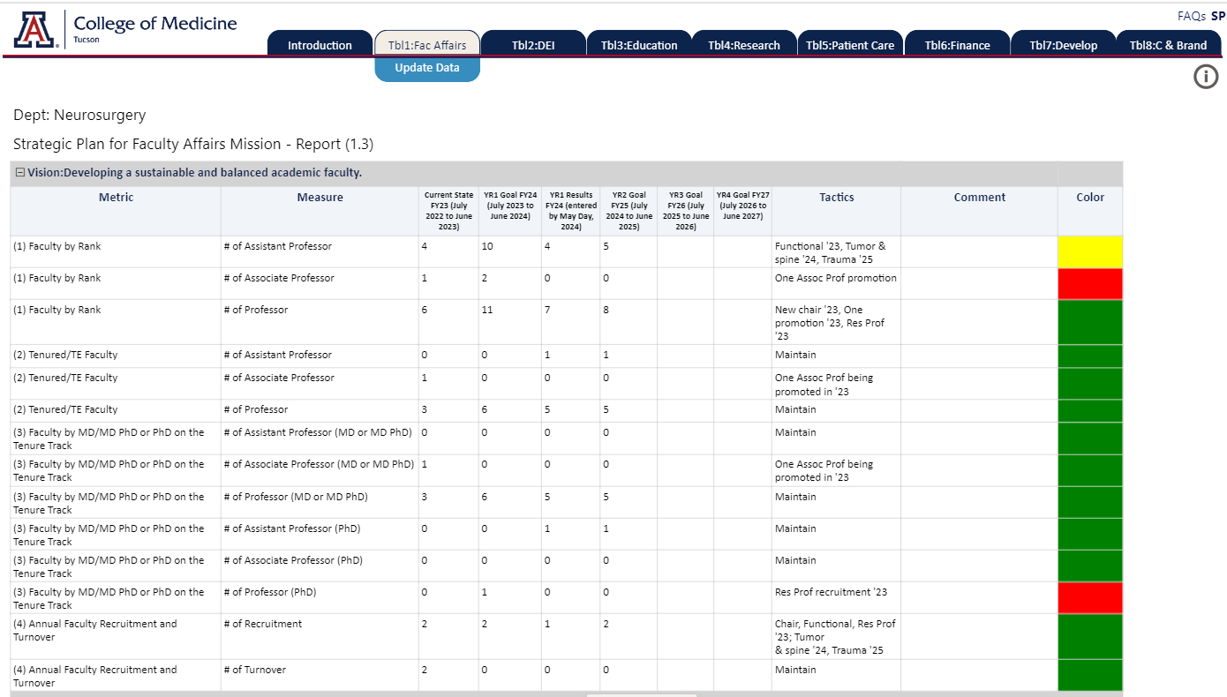
After selecting a tab, in this case Faculty Affairs, two sub tabs appear:
The top (yellow) tab is a report of what is currently in the system
The bottom (turquoise) tab is where data can be entered
This column utilizes a “stoplight” status system (green, red, yellow)
Please see slide #13 for an explanation on how the rows in this column automatically change from one color to another color
The report is broken down by Visions, in this case, “Developing a sustainable and balanced academic faculty”

Slide 18
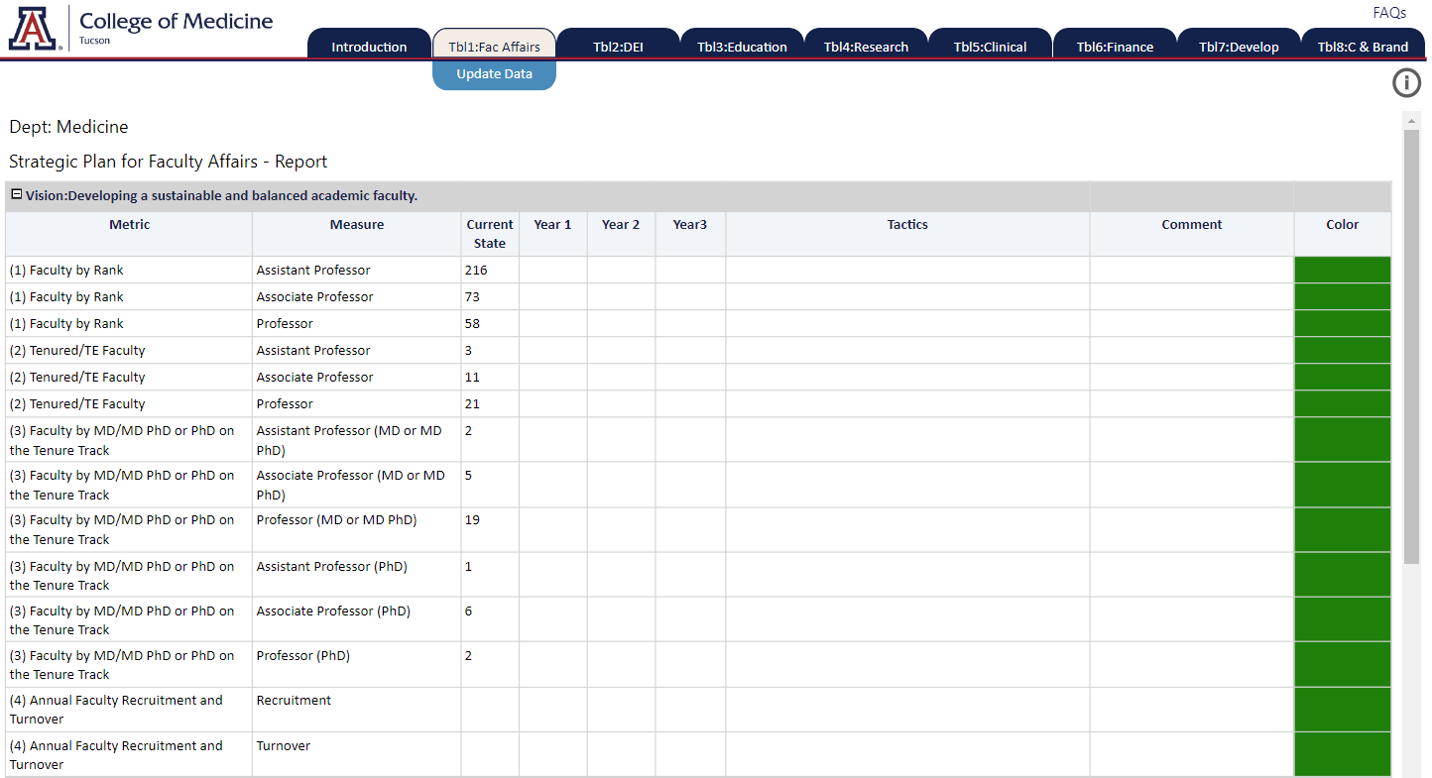
The cells the Department is required to complete will be highlighted in a pale yellow. If the cells are white, the Department is not required to enter information into that cell.
PLEASE NOTE: This example is only for purposes of this User Guide; it DOES NOT mean the Department of Medicine is only required to enter data for this Metric & Measure

Slide 19
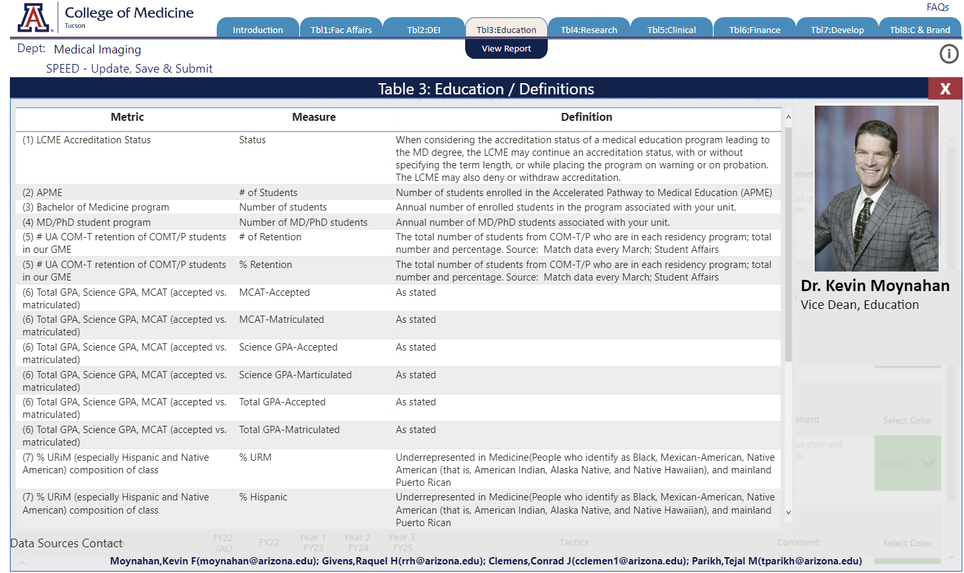
Mission Area Leader and Mission Information
From both the Report View and the Update Data View, you can access information about the Mission Leader as well as information about the Mission has been selected (in this case, Faculty Affairs)
Select the “I” Information Logo at the top right-hand side of the screen

Slide 20
For questions regarding SPEED, please contact the individual Mission leaders
For technical support, please submit a ticket in COMHelp https://comhelp.arizona.edu

